Slide 1
Transactions Processing
IE2042- Database Management Systems for Security- Lecture8

Slide 2

Learning Outcomes (LO4)
Understand the concept of a transaction
Understand the properties of a transaction
Identify different ways of scheduling transactions
Understand the problems of unserializable schedules
Determine solutions to handle unserializability

Slide 3
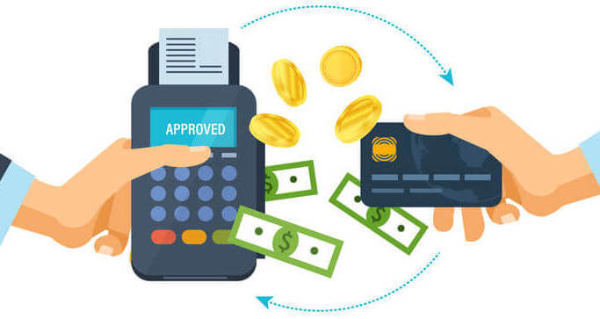
What is a Transaction?
A user’s program may carry out many operations on the data retrieved from the database, but the DBMS is only concerned about what data is read or written from or to the database
An action, or series of actions, carried out by a single user or application program, which reads or updates the contents of the database
A transaction is a sequence of reads and writes.
Example: Transferring a balance from Account A to Account B

Slide 4
What is a Transaction?
You transfer money from your account to a seller’s account
Read your account balance
Add the amount to seller’s account balance
Write the new updated balance to seller’s account
Deduct the amount from your balance
Write the remaining balance of your account
Read seller’s account balance

Slide 5
Properties of a Transaction
Atomicity
Consistency
Isolation
Durability
ACID

Slide 6
Atomicity
Atomicity ensures that the transaction is executed as a single unit of work. That is, for every transaction, either all actions within the transaction are carried out or none are (All or Nothing)
A transaction might commit after completing all its actions, or it could abort (or be aborted by the DBMS) after executing some actions
In a committed transaction all actions are executed within a DBMS and in an aborted transaction none of the actions are executed
DBMS logs all actions so that it can undo the actions of aborted transactions.
Recovery manager is responsible to ensuring atomicity

Slide 7
Consistency
Consistency ensures that every transaction sees a consistent database instance
Users/ developers are mainly responsible for ensuring transaction consistency
Integrity constraints are verified by DBMSs. But program logic must guarantee the consistency of a transactions
E.g. Transferring the balance from one account to another. The total amount in both accounts before and after the transaction must be equal
Start of the Transaction
End of the Transaction
Temporary Inconsistent state of the database
Transaction Time
Database in a consistent state

Slide 8
Isolation
Executed independently of one another
Isolation property ensures that even though actions of several transactions are interleaved, the net effect is identical to executing all transactions in some serial order
Concurrency control sub system is responsible to ensure isolation

Slide 9
Durability
Durability ensures that the transactions survive system crashes and failures
That is, a committed transaction is always reflected in the database and an uncommitted transaction is always rolled backed after a system crash
DBMS maintains a log & recovery manager is responsible to ensuring durability

Slide 10
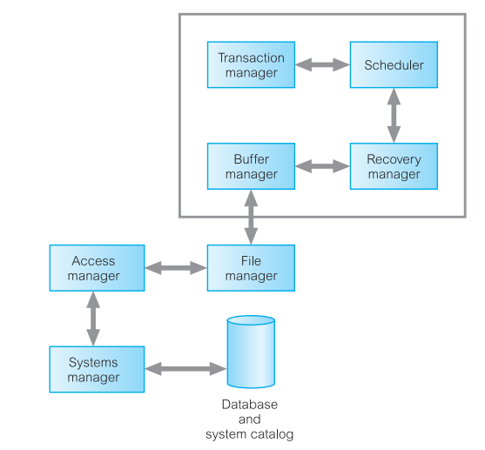
Database Architecture
Transaction manager coordinates transactions on behalf of application programs.
It communicates with the scheduler, the module responsible for implementing a particular strategy for concurrency control. The scheduler is sometimes referred to as the lock manager if the concurrency control protocol is locking-based. The objective of the scheduler is to maximize concurrency without allowing concurrently executing transactions to interfere with one another, and so compromise the integrity or consistency of the database.
If a failure occurs during the transaction, then the database could be inconsistent. It is the task of the recovery manager to ensure that the database is restored to the state it was in before the start of the transaction, and therefore a consistent state.
Finally, the buffer manager is responsible for the efficient transfer of data between disk storage and main memory.

Slide 11
Transactions and Schedules
A transaction is seen by a DBMS as a series of ordered actions
Actions include reads and writes of database objects
Notation:
Transaction T reading object O : R_{T}(O)
Transaction T writing object O : W_{T}(O)
In addition, the final action of a transaction is commit or abort.
Notation:
Commiting transaction T: Commit_{T}
Aborting transaction T : Abort_{T}
Note: We omit the subscript T where unambiguous

Slide 12
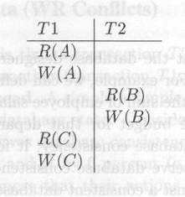
Transactions and Schedules
Schedule: A list of actions (reads, writes, commits, aborts) from a set of transactions and the order of actions in the schedule is the same as the order of actions in transactions
Intuitively, a schedule represents an actual or potential execution sequence.

Slide 13
Concurrent execution of Transactions
DBMS interleaves actions of different transactions to improve performance
Motivation for concurrent transactions
CPU can process one transaction while another is waiting for a page to be read from disk
Interleaving short transactions with longer transactions allows to complete quicker
Example
T1: A transaction calculates the interest for all accounts in the bank (Takes 2 hours)
T2: A customer wants to withdraw funds from an account (Takes 1 minute)

Slide 14
Scheduling Transactions
Serial schedule: Schedule that does not interleave the actions of different transactions.
Equivalent schedules: For any database state, the effect (on the set of objects in the database) of executing the first schedule is identical to the effect of executing the second schedule.
Serializable schedule: A schedule that is equivalent to some serial execution of the transactions.
(Note: If each transaction preserves consistency, every serializable schedule preserves consistency)

Slide 15
Serializability
Multiple transactions executed concurrently must be equivalent to some serial execution of the transactions in order to preserve consistency
Order of transactions within the schedule doesn’t matter

Slide 16
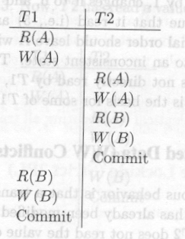
Anomalies with Interleaved Execution
Reading Uncommitted Data
(WR Conflicts, “dirty reads”)
T1 transfers
fund
T2 calculates
interest

Slide 17
Anomalies with Interleaved Execution
2. Unrepeatable Reads
(RW Conflicts)
T1: R(A), R(A), W(A), C
T2: R(A), W(A), C
Example T1 is incrementing A by 1 and T2 is decrementing A by 1

Slide 18
Anomalies with Interleaved Execution
3. Overwriting Uncommitted Data
(WW Conflicts)
T1: W(A), W(B), C
T2: W(A), W(B), C
Values of A and B are equal.
T1 makes A & B to be 1000.
T2 makes A & B to be 2000.

Slide 19
Unserializability
The root cause for unserializable schedules (or violation of Isolation property) are conflicts.
WR conflict
RW conflict
WW conflict
Idea: Avoid conflicts!!!

Slide 20
Lock Based Concurrency Control
Strict Two-phase Locking (Strict 2PL) Protocol:
Each transaction must obtain a S (shared) lock on object before reading, and an X (exclusive) lock on object before writing.
All locks held by a transaction are released when the transaction completes
If a transaction holds an X lock on an object, no other transaction can get a lock (S or X) on that object.

Slide 21
Strict 2PL
Strict 2PL does not allow
WR conflict
RW conflict
WW conflict
How?
Therefore, Strict 2PL allows only serializable schedules.

Slide 22
Aborting a Transaction
If a transaction T1 is aborted, all its actions have to be undone
Not only that, if T2 reads an object last written by T1, then T2 must be aborted as well!
Some considerations with aborts:
Cascading aborts
Unrecoverable Schedules

Slide 23
Cascading Abort
Abort of one transaction causes the abort of another transaction
Example
T₁ T₂
W(A)
R(A)
abort
T₁’s abort causes abort of T₂ as well

Slide 24
Cascading Abort
Root cause for cascading abort:
WR conflict +
Transaction which wrote the data aborts
Good News: Strict 2PL does not allow cascading aborts!!!
How?
This is also known as avoiding cascading aborts

Slide 25
Unrecoverable Schedule
An unrecoverable schedule:
T₁ | T₂
W(A)
 | R(A)
 | W(B)
 | W(A)
 | Commit
abort

Slide 26
Unrecoverable Schedule
Root cause for unrecoverable schedule:
WR conflict +
Transaction which read the data commits before transaction which wrote the data
Good News: Strict 2PL does not allow unrecoverable schedules!!!
How?

Slide 27
The Log
In order to undo the actions of an aborted transaction, the DBMS maintains a log in which every write is recorded.
This mechanism is also used to recover from system crashes: all active transactions at the time of the crash are aborted when the system comes back up
The following actions are recorded in the log:
Ti writes an object: the old value and the new value.
Log record must go to disk before the changed page!
Ti commits/aborts: a log record indicating this action.
Log records are chained together by transaction id, so it’s easy to undo a specific transaction.
All log related activities (and in fact, all CC related activities such as lock/unlock, dealing with deadlocks etc.) are handled transparently by the DBMS.

Slide 28

The End…
Complete the tutorial

